Slide 1
Three Ways of Women Representation in Advertisements
GÖZDE DİNÇ/1791185
Psychology

Slide 2
Outline
Introduction
Artificial Look
Women Objectification
Women as housewifes and mothers
Conclusion

Slide 3

Artificial Look
http://goayjl.wordpress.com

Slide 4

Artificial Look
http://goayjl.wordpress.com

Slide 5
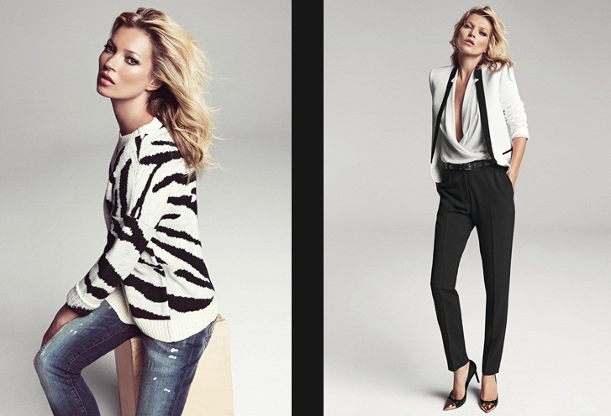
Artificial Look
www. Mango.com

Slide 6

Objectification
http://sophieparisbagsquality.blogspot.com

Slide 7
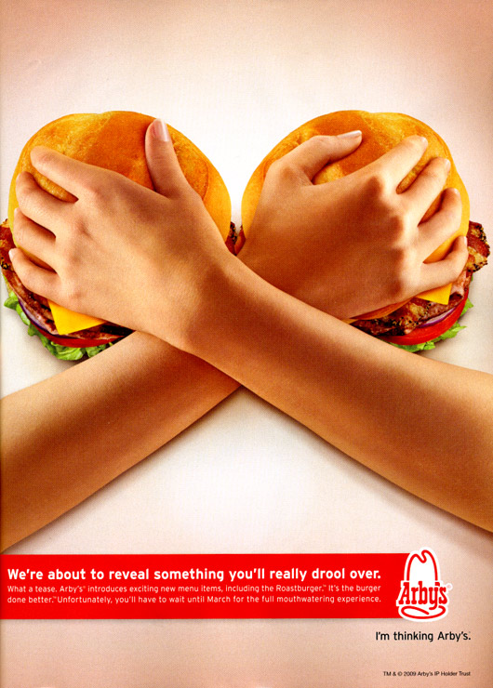
Objectification
http://www.eatmedaily.com

Slide 8
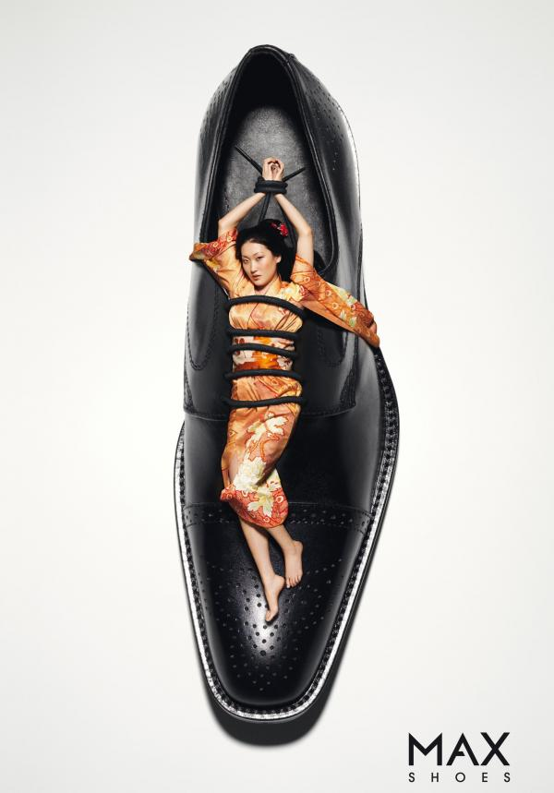
Objectification
http://www.coloribus.com

Slide 9
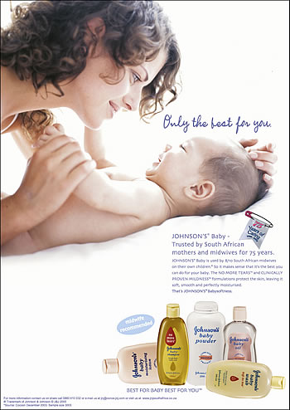
Women as housewifes and mothers
http://www.starlightzcasting.com

Slide 10
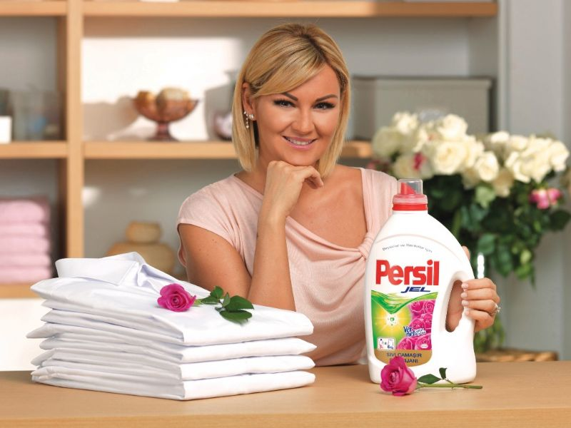
Women as housewifes and mothers
http://www.avmlife.com.tr

Slide 11
To conclude…

Slide 12
References
Arime, N. A. (2003). Gender Stereotypes in Japanese Television Advertisements. Sex
Roles, 49, 81-90.
Chafai, H. (2010). Gender And The Language Of Advertising: A Sociolinguistic
Analysis Of Women's Representation In British And Moroccan Magazine
Advertisements. Germany: VDM Verlag Dr. Müller.
Rahim, M. H. A., Mustaffa, N., & Mun, L. S. (2011). The effects of gender
advertising on brand image: the Malaysian context. Jurnal Komunikasi ;
Malaysian Journal of Communication, 27 (1), 118-133.
.

Slide 13
References
Rusínová, M. (2010). Gender in advertising – Advertising during 20th century with
the intention of gender stereotypes. (Bachelor Thesis). Tomas Bata University,
Zlín, Czech Republic

Slide 14
References
http://goayjl.wordpress.com
http://goayjl.wordpress.com
www. mango.com
http://sophieparisbagsquality.blogspot.com
http://www.eatmedaily.com
http://www.coloribus.com
http://www.starlightzcasting.com
http://www.avmlife.com.tr
tp://www.glittergraphics.org

Slide 15

http://www.glittergraphics.org

